Slide 1

Chiropractic Website
CTC Development Team

Slide 2




CTc Development Team Members
Lucas Lawless
HTML Designer/Programmer
Callan Bramblett
Java Programmer
Victorino Martinez
Java Programmer

Slide 3
Lucas Lawless
Contributions
- HTML Lead
- Logo Design
- Webpage/Stylesheet Design
- Assistant programmer
Callan Bramblett
Victorino Martinez
Contributions
- Java Programmer
- B.O. Design
- Servlet Design
- JSP Assistant
- Documentation Development
Contributions
- Java Programmer
- Wireframe/Flowchart Design
- B.O. Design
- Servlet Design
- Presentation Development

Slide 4
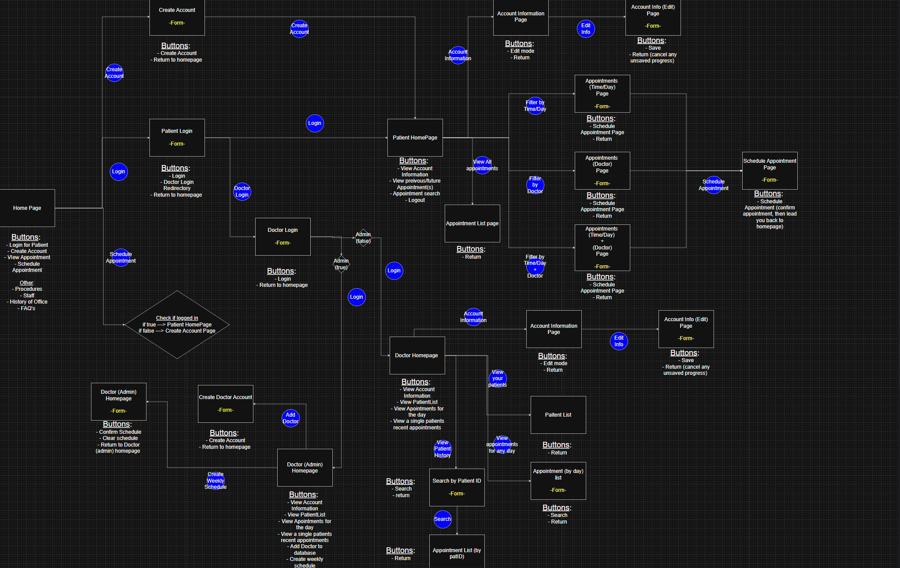
Design Process
A general overview of the design process. This flowchart was made in the beginning of our project life cycle, and was used to provide a guide of how our projects pages would interact with each other.
Showcasing the path for patient doctor, and administrator interactions was the primary reason for creating this chart

Slide 5
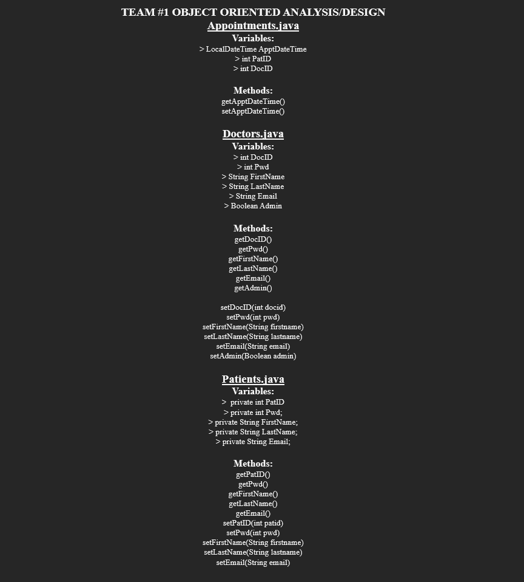
Object Oriented Analysis/Design
Here is our initial plan regarding how our objects would be designed and laid out.

Slide 6
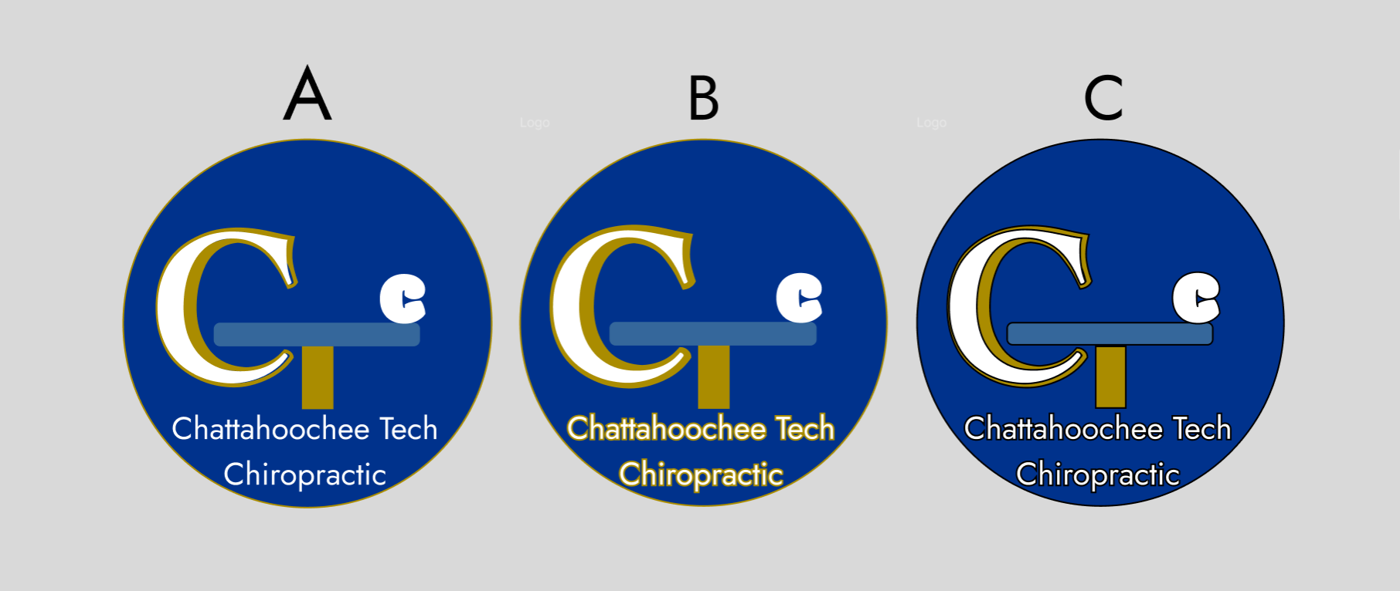
Logo Concepts
This was used as the final design of our logo
Here we have our initial prototypes of your logo

